Slide 1
Feedback Submission System
The project made by Aruuke Kenzhalieva

Slide 2
Project Overview
The main purpose of this project is to manage user feedback efficiently.
The system supports:
Adding feedback
Viewing feedback list
Updating feedback
Deleting feedback
All data is stored in a CSV file to ensure persistence even after program restart.

Slide 3
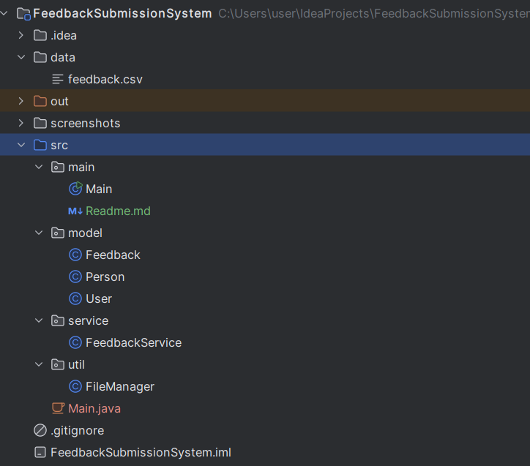
Design & Structure
The project is divided into packages:
model - Feedback class (data structure)
service - business logic (add, update, delete)
util - file handling (CSV read/write)
main - user interface (menu system)

Slide 4
Data Structures & File Handling
The project uses:
ArrayList → to store feedback in memory
CSV file → to store data permanently
Algorithm flow:
1.Load data from CSV
2.Store in ArrayList
3.Perform operations (CRUD)
4.Save back to CSV

Slide 5
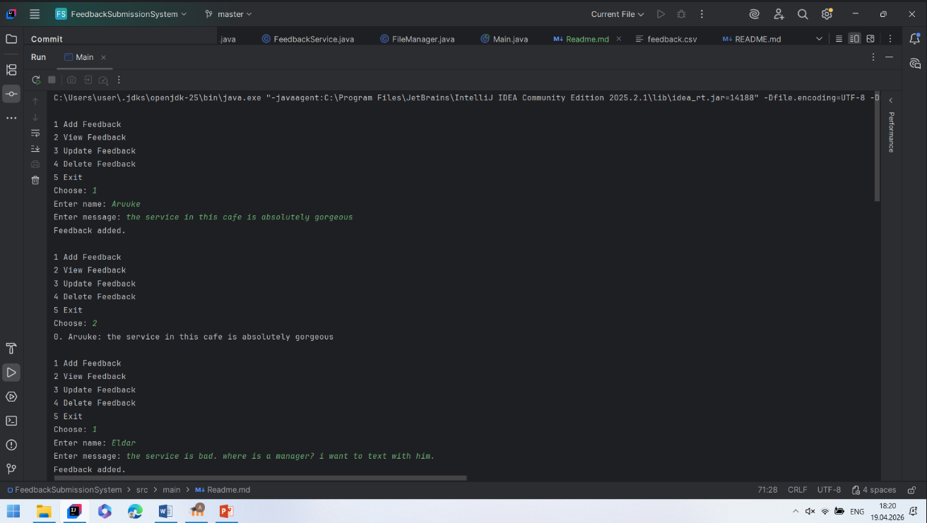
Functionality Demonstration
During execution, the user can:
Add feedback (name + message)
View all feedback entries
Update existing feedback
Delete feedback by index Example input is in the screenshot

Slide 6
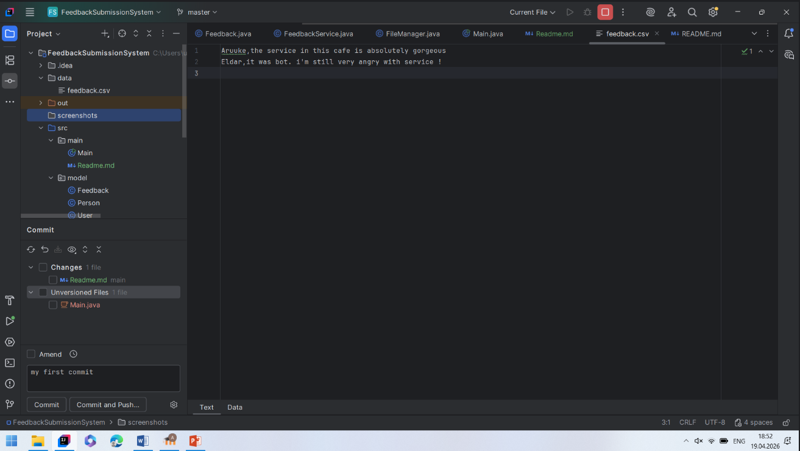
In the feedback.csv

Slide 7
Thank you for your attention!

